Slide 1
Time Turner
Qiong Hu
Electrical and Computer Engineering, UCLA

Slide 2
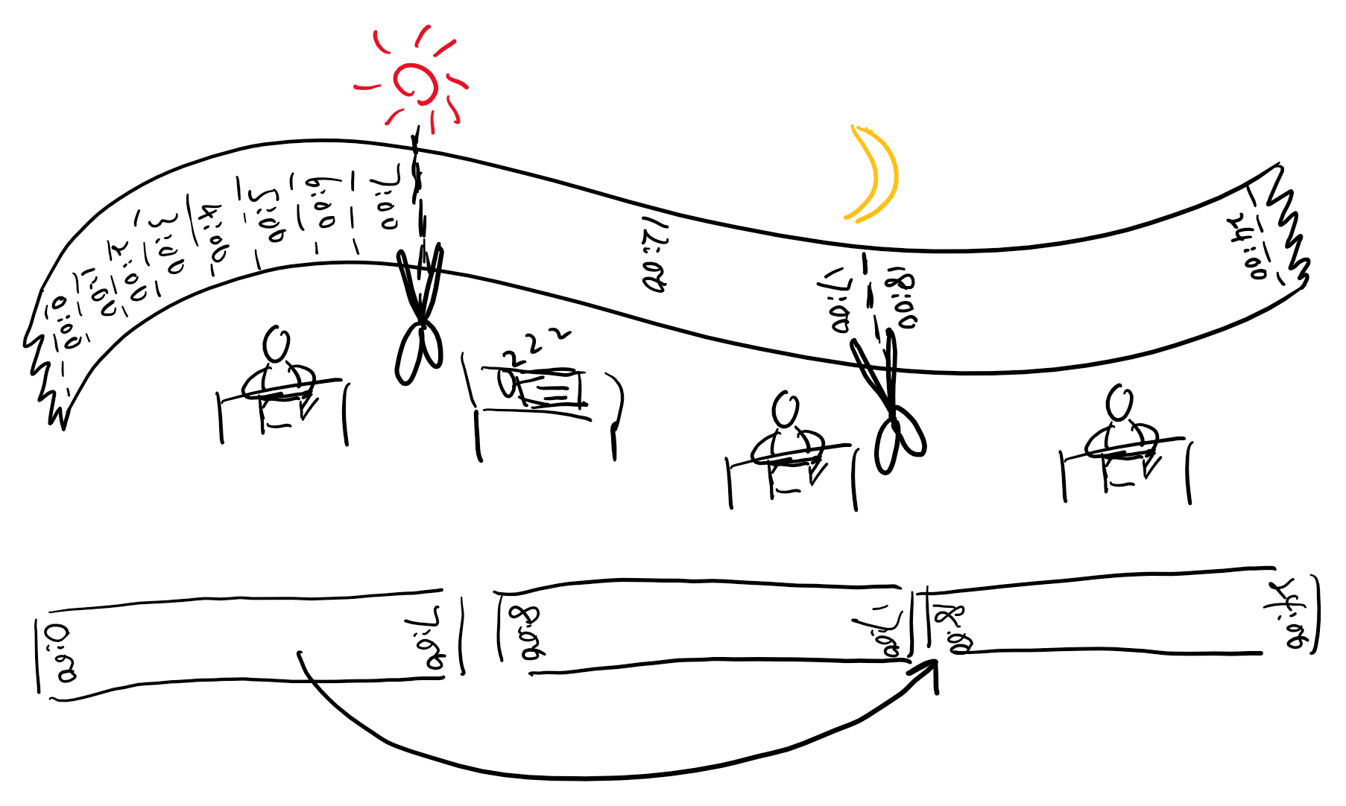
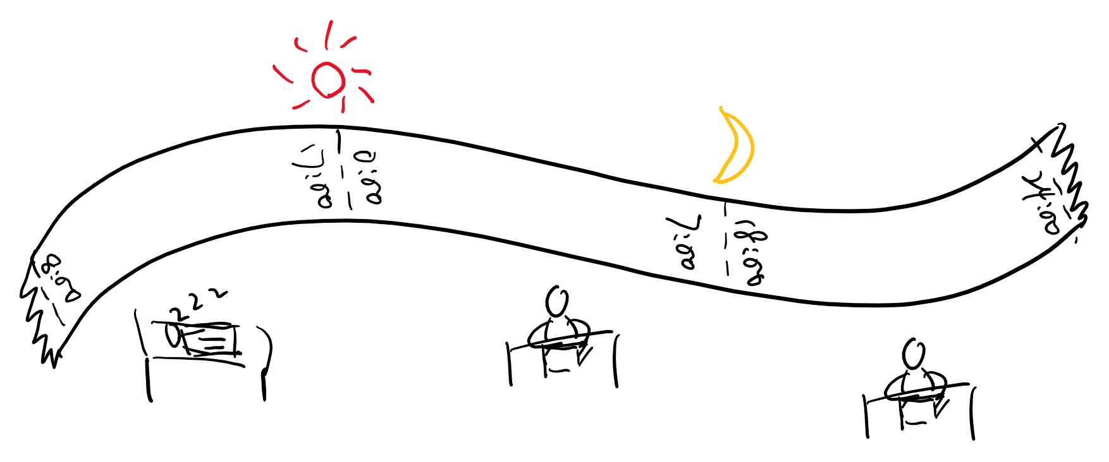

Slide 3
